Slide 1
Design Structure Matrix

Slide 2
Design Structure Matrix
A DSM displays the relationships between components of a system in a compact, visual, and analytically advantageous format.
A DSM is a square matrix with identical row and column labels.
Reading across a row reveals what other elements the element in that row provides to.
Scanning down a column reveals what other elements the element in that column depends on.
That is, reading down a column reveals input sources, while reading across a row indicates output sinks.

Slide 3
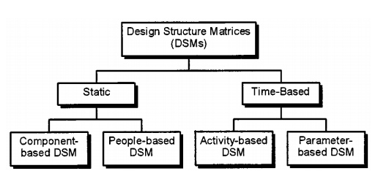

Slide 4
There are two main categories of DSMs: static and time-based.
Static DSMs represent system elements existing simultaneously, such as components of a product architecture or groups in an organization.
Static DSMs are usually analyzed with clustering algorithms.
In time-based DSMs, the ordering of the rows and columns indicates a flow through time: upstream activities in a process precede downstream activities, and terms like “feedforward” and “feedback” become meaningful when referring to interfaces.
Time-based DSMs are typically analyzed using sequencing algorithms.

Slide 5
DSM Data Types | Representation | Application | Analysis Method
DSM Data Types | Representation | Application | Analysis Method
Task-based | Task/Activity input/output relationships | Project scheduling, activity sequencing, cycle time reduction | Partitioning, Tearing, Banding
Parameter-based | Parameter decision points and necessary precedents | Low level activity sequencing and process construction | Partitioning, Tearing, Banding
Team-based | Multi-team interface characteristics | Organizational design, interface management, team integration | Clustering
Component-based | Multi-component relationships | System architecting, engineering and design | Clustering

